Slide 1
Chongqing University of Technology
ATAI
Advanced Technique of Artificial Intelligence
Chongqing University of Technology
Code:None
Multi-Scale Variational Graph AutoEncoder for Link Prediction
WSDM_2022
Reported by Xinsheng Wang

Slide 2
Chongqing University of Technology
ATAI
Advanced Technique of Artificial Intelligence
Chongqing University of Technology
1.Introduction
2.Method
3.Experiments

Slide 3
Introduction
Previous work
Graph(A,X)
Encoder
Decoder
Reconstruct Graph(A)
It is worth noting that the methods described above only learn a set of low-dimensional vectors to
represent the features of nodes when learning low-dimensional vectors representing graph data.

Slide 4
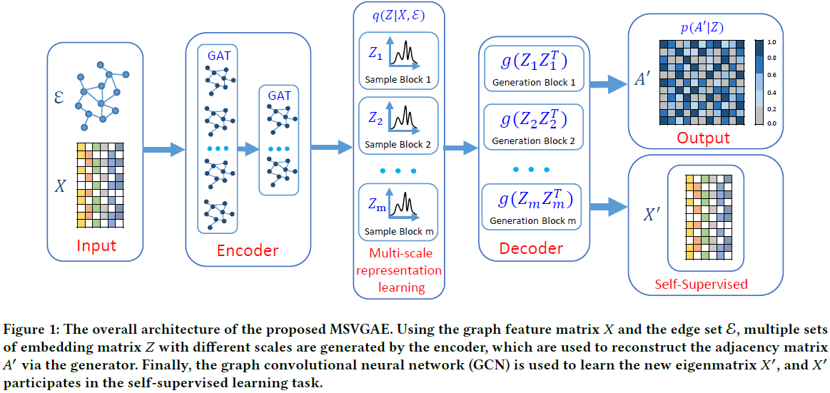
Method

Slide 5
Method
Encoder
K-head attention

Slide 6
Method
Multi-Scale Learning

Slide 7
Method
Decoder
Notes:
引入多尺度表示学习主要是为了学习邻接矩阵A，在其中加入自监督损失。

Slide 8
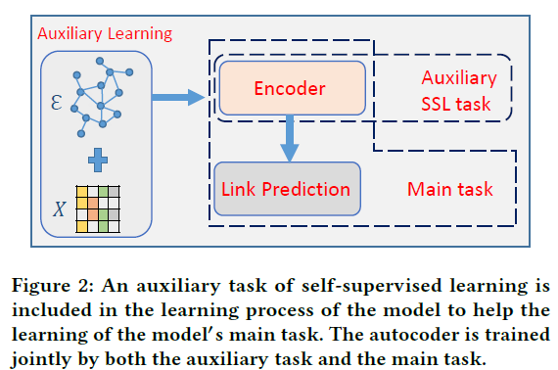
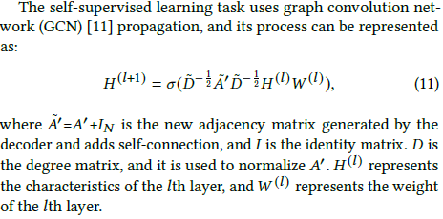
Method
Self-Supervised Learning Task
Self-supervised

Slide 9
Method
Loss Function
Notes:
第一个是邻接矩阵之间的距离，第二个是encoder之后隐藏状态Z的距离，第三个是最终的邻接矩阵GCN之后得到的X‘与原始X的距离。

Slide 10
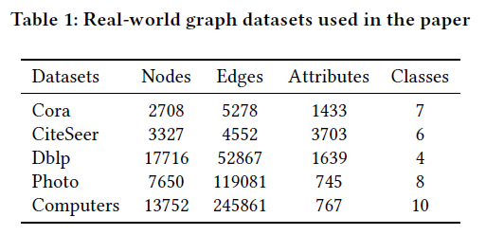
Experiments

Slide 11
Experiments

Slide 12
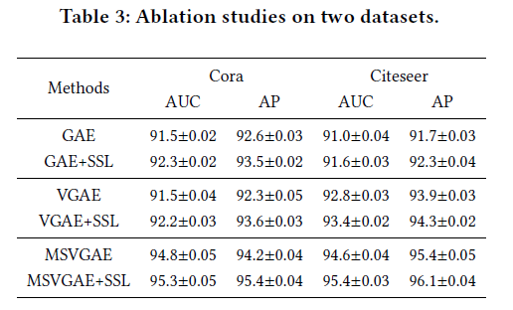
Experiments

Slide 13
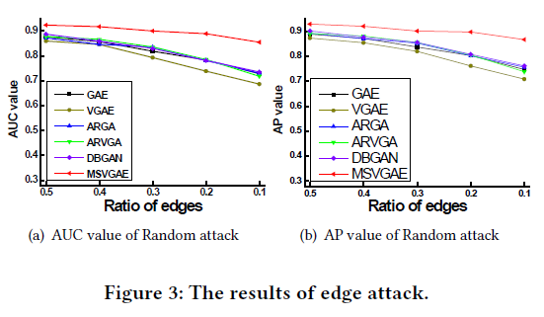
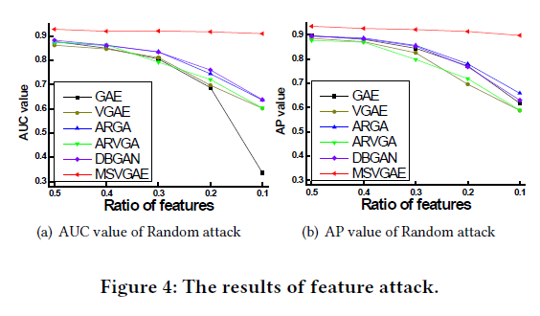
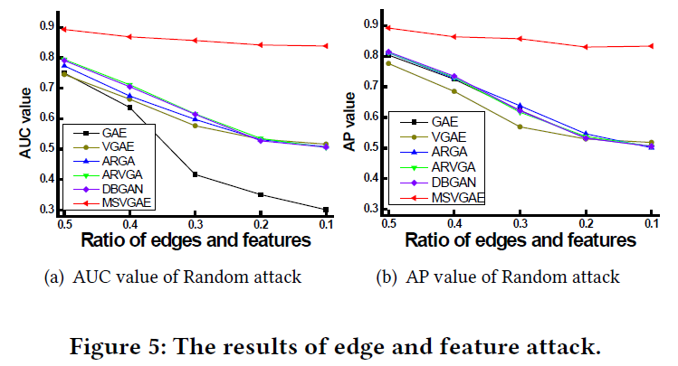
Experiments

Slide 14
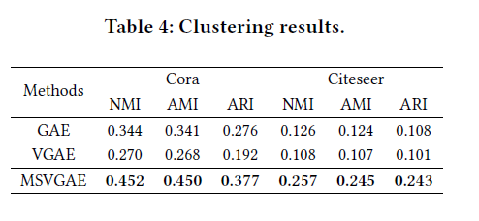
Experiments

Slide 15
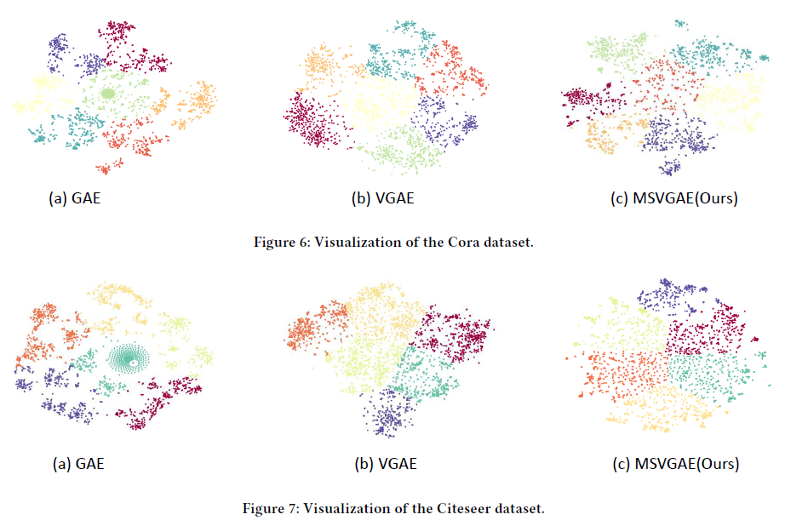
Experiments

Slide 16
Thank you!

